Slide 1
IMDB Movie Assistant
LangGraph-Powered Hybrid Query System

Slide 2
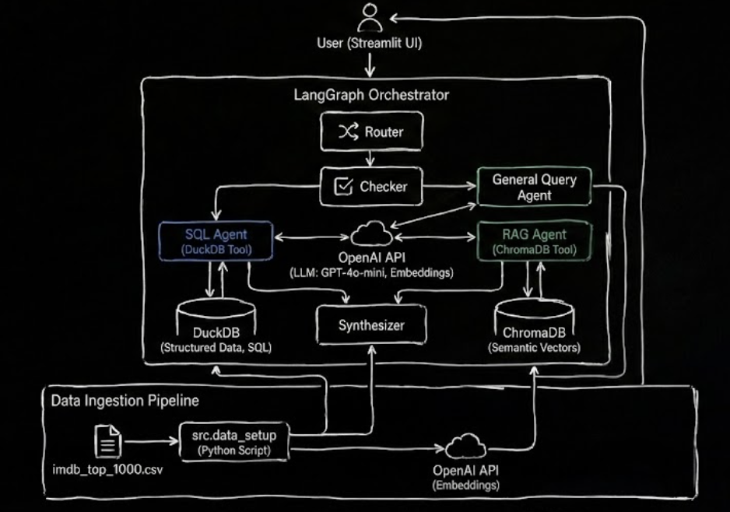
Project overview
Multi-agent IMDB chatbot combining DuckDB SQL and ChromaDB semantic search via LangGraph orchestration.
Tech Stack
LangGraph: multi-agent orchestration
DuckDB: in-process OLAP SQL engine
(fast for analytics)
ChromaDB: vector store with OpenAI embeddings
GPT-4o-mini: low cost model for all agents
SQLite3: To store chat in memory
Streamlit: for Frontend

Slide 3
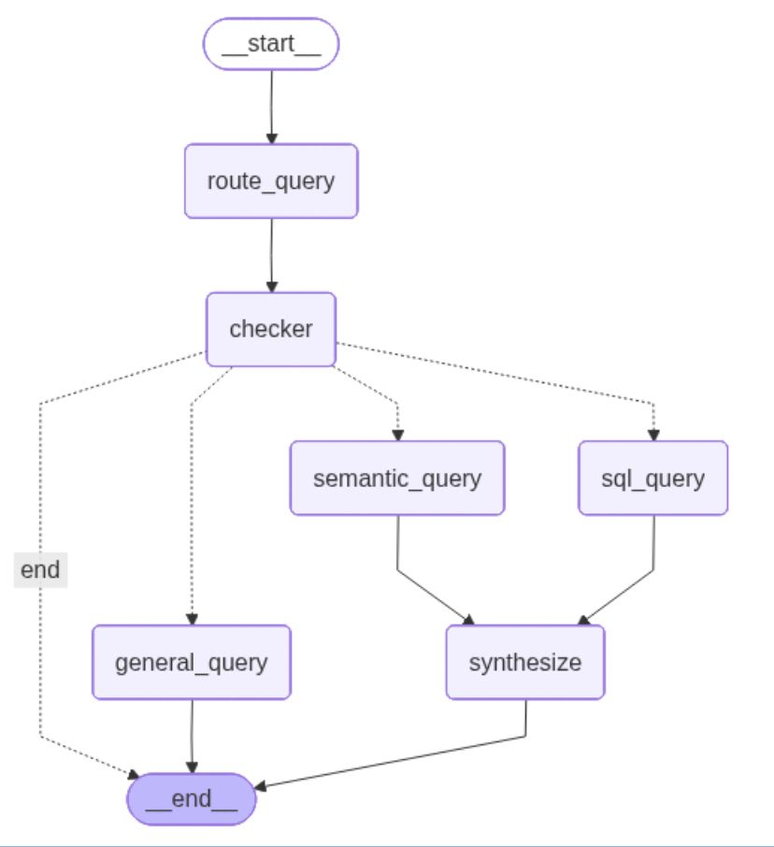
Problem Statement
The Challenge
Build a conversational AI agent that answers questions about IMDB Top 1000 movies, handling:
Query Complexity:
Structured filtering: "Top 5 movies of 2019 by meta score"
Semantic understanding: "Movies with police involvement in the plot"
Complex combinations: "Comedy movies where death is involved"
Clarification needed: "Al Pacino movies over $50M" (lead role or any role?)
Functional Requirements:
9 diverse test questions (from simple lookups to complex aggregations)
Need both precise filtering AND theme-based search
Conversational interface with memory
Reasoning and suggestions in responses

Slide 4
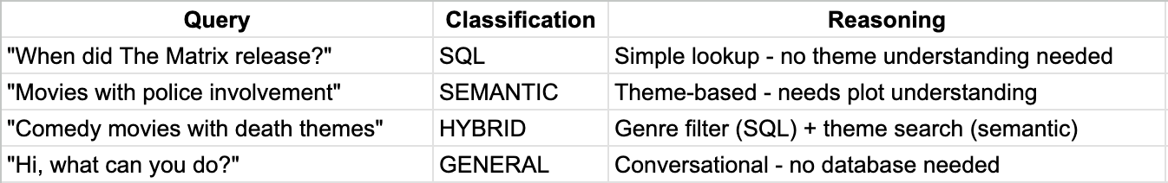
Feature 1&2: Query Classification & Open-ended Detection
Router Agent analyzes query intent:
Open-ended question’s detected:
"Good movies" → What criteria? Rating? Votes? Gross?
"Popular films" → By IMDB rating, number of votes, or box office?
"Leonardo DiCaprio sci-fi" → Lead role only or any role?

Slide 5
Feature 3&4: Error Handling & Short Term Memory
Graceful degradation:
SQL syntax error → Try semantic search as fallback
Vector store unavailable → SQL-only mode
LLM error → User-friendly message with retry suggestions
No results → Suggest broader criteria
Persistent Memory:
Multi-turn context: Agent remembers previous queries across sessions (e.g., "Show Spielberg movies" → "Which has highest rating?")
Thread persistence: Each conversation stored as unique thread ID via LangGraph's SqliteSaver - survives browser closes/reopens
Thread-safe design: Concurrent access support with check_same_thread=False for multi-user Streamlit deployment

Slide 6
Feature 5&6: LangSmith Integration & Database Selection
Production-Grade Monitoring:
Distributed tracing: Track all 5 agents (router → checker → SQL/RAG → synthesizer) with execution times, token costs, and state transitions
Zero-code instrumentation: automatic LLM call tracking, prompt visibility, and error pinpointing
Performance optimization: Identify bottlenecks (slow SQL queries, expensive embeddings) and debug multi-agent failures instantly
Database Selection:
ChromaDB over FAISS: Persistent disk storage, native metadata filtering, easy updates - production-ready vs research library
DuckDB over PostgreSQL: Embedded single-file, OLAP-optimized columnar storage for fast analytics handles 100M+ rows
Hybrid architecture: DuckDB for precise filters/aggregations + ChromaDB for semantic similarity + SQLite for conversation state = optimal performance per use case

Slide 7
Thank You

